Slide 1




University Institute of Engineering
Department of Computer Science & Engineering
COMPUTER ORGANIZATION & ARCHITECTURE
(23CST-204/23ITT-204)
ER. SHIKHA ATWAL
E11186
ASSISTANT PROFESSOR
BE-CSE

Slide 2
MAIN MEMORY
The main memory acts as the central storage unit in a computer system. It is a relatively large and fast memory which is used to store programs and data during the run time operations.
The primary technology used for the main memory is based on semiconductor integrated circuits.
The integrated circuits for the main memory are classified into two major units.
RAM (Random Access Memory) integrated circuit chips
ROM (Read Only Memory) integrated circuit chips

Slide 3
1. RAM integrated circuit chips
The RAM integrated circuit chips are further classified into two possible operating modes, static and dynamic.
The primary compositions of a static RAM are flip-flops that store the binary information. The nature of the stored information is volatile, i.e. it remains valid as long as power is applied to the system. The static RAM is easy to use and takes less time performing read and write operations as compared to dynamic RAM.
The dynamic RAM exhibits the binary information in the form of electric charges that are applied to capacitors. The capacitors are integrated inside the chip by MOS transistors. The dynamic RAM consumes less power and provides large storage capacity in a single memory chip.
RAM chips are available in a variety of sizes and are used as per the system requirements.

Slide 4
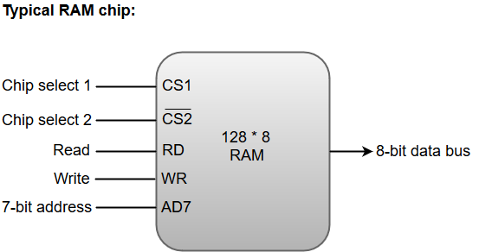
The following block diagram demonstrates the chip interconnection in a 128 * 8 RAM chip.
A 128 * 8 RAM chip has a memory capacity of 128 words of eight bits (one byte) per word. This requires a 7-bit address and an 8-bit bidirectional data bus.
The 8-bit bidirectional data bus allows the transfer of data either from memory to CPU during a read operation or from CPU to memory during a write operation.

Slide 5
The read and write inputs specify the memory operation, and the two chip select (CS) control inputs are for enabling the chip only when the microprocessor selects it.
The bidirectional data bus is constructed using three-state buffers.
The output generated by three-state buffers can be placed in one of the three possible states which include a signal equivalent to logic 1, a signal equal to logic 0, or a high-impedance state.
Note: The logic 1 and 0 are standard digital signals whereas the high-impedance state behaves like an open circuit, which means that the output does not carry a signal and has no logic significance.

Slide 6
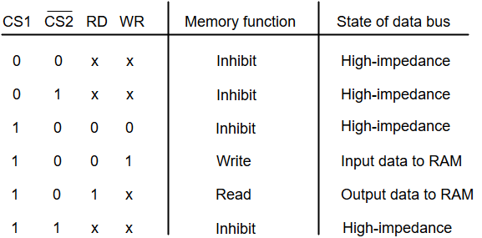
The following function table specifies the operations of a 128 * 8 RAM chip.
From the functional table above, we can conclude that the unit is in operation only when CS1 = 1 and CS2 = 0. The bar on top of the second select variable indicates that this input is enabled when it is equal to 0.

Slide 7
2. ROM integrated circuit
The primary component of the main memory is RAM integrated circuit chips, but a portion of memory may be constructed with ROM chips.
A ROM memory is used for keeping programs and data that are permanently resident in the computer.
Apart from the permanent storage of data, the ROM portion of main memory is needed for storing an initial program called a bootstrap loader. The primary function of the bootstrap loader program is to start the computer software operating when power is turned on.
ROM chips are also available in a variety of sizes and are also used as per the system requirement. The following block diagram demonstrates the chip interconnection in a 512 * 8 ROM chip.

Slide 8
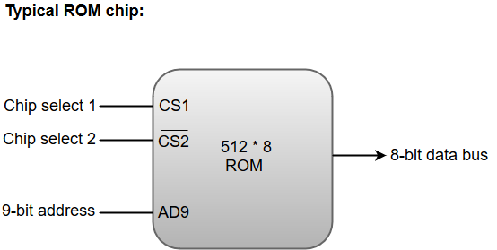
A ROM chip has a similar organization as a RAM chip. However, a ROM can only perform read operation; the data bus can only operate in an output mode.
The nine address lines in the ROM chip specify any one of the 512 bytes stored in it.
The two chip select inputs must be CS1=1 and CS2=0 for the unit to operate. Otherwise, the data bus is said to be in a high-impedance state.

Slide 9
Memory Address Map
The system designer must calculate the amount of memory required for a given application and assign it to RAM or ROM.
The interconnection between the processor and the memory is established from the knowledge of the size of memory required and the type of ROM and RAM chips available. The addressing of memory can be established by means of a table that specify the memory address assigned to each chip. The table is called the Memory address map, is a pictorial representation of assigned address space for each chip in the system.

Slide 10
Component | Hexadecimal Address | Address Bus
 |  | 10 | 9 | 8 | 7 | 6 | 5 | 4 | 3 | 2 | 1
RAM 1 | 0000-007F | 0 | 0 | 0 | X | X | X | X | X | X | X
RAM 1 | 0080-007F | 0 | 0 | 1 | X | X | X | X | X | X | X
RAM 1 | 0100-017F | 0 | 1 | 0 | X | X | X | X | X | X | X
RAM 1 | 0180-01FF | 0 | 1 | 1 | X | X | X | X | X | X | X
ROM | 0200-03FF | 1 | X | X | X | X | X | X | X | X | X
The memory address map for the configuration of 512 bytes RAM and 512 bytes ROM is shown in table above. The component column specifies whether a RAM or a ROM chip is used. The hexadecimal address column assigns a range of hexadecimal equivalent addresses for each chip. The address bus lines are listed in the third column. The RAM chips have 128 bytes and need seven address lines. The ROM chip has 512 bytes and needs 9 address lines.

Slide 11
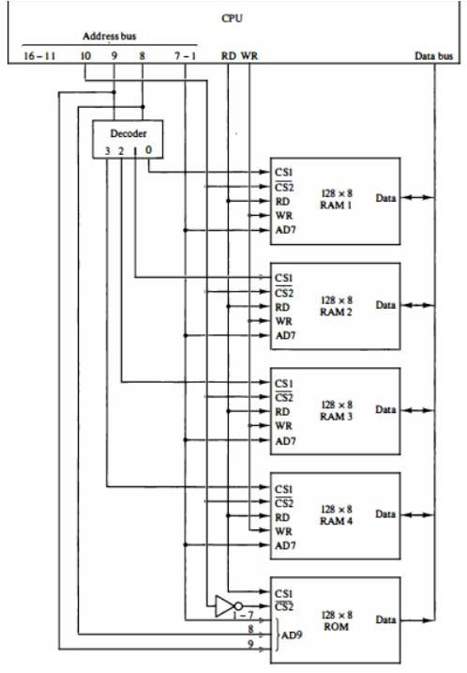
Memory Connection to CPU
The data and address buses are used to connect RAM and ROM chips to a CPU.
The low-order lines in the address bus choose the byte within the chips and other lines in the address bus select a particular chip through its chip select inputs.
Memory Connection to the CPU

Slide 12
The connection of memory chips to the CPU is shown in the figure above. This configuration gives a memory capacity of 512 bytes of RAM and 512 bytes of ROM. Each RAM receives the seven low-order bits of the address bus to select one of 128 possible bytes.
The particular RAM chip selected is determined from lines 8 and 9 in the address bus. This is done through a 2 X 4 decoder whose outputs go to the CS1 inputs in each RAM chip.
Thus, when address lines 8 and 9 are equal to 00, the first RAM chip is selected. When 01, the second RAM chip is select, and so on.
The RD and WR outputs from the microprocessor are applied to the inputs of each RAM chip. The selection between RAM and ROM is achieved through bus line 10. The RAMs are selected when the bit in this line is 0, and the ROM when the bit is 1.

Slide 13
Address bus lines 1 to 9 are applied to the input address of ROM without going through the decoder. The data bus of the ROM has only an output capability, whereas the data bus connected to the RAMs can transfer information in both directions.

Slide 14
References
Reference Books:
J.P. Hayes, “Computer Architecture and Organization”, Third Edition.
Mano, M., “Computer System Architecture”, Third Edition, Prentice Hall.
Stallings, W., “Computer Organization and Architecture”, Eighth Edition, Pearson Education.
Text Books:
Carpinelli J.D,” Computer systems organization &Architecture”, Fourth Edition, Addison Wesley.
Patterson and Hennessy, “Computer Architecture”, Fifth Edition Morgaon Kauffman.

Slide 15
Reference Website:
Memory Hierarchy Design and its Characteristics - GeeksforGeeks
What is memory hierarchy? (tutorialspoint.com)
Video Links:
https://youtu.be/oj4_c9IMOCg?si=1FMiriyxX7JwkE4h
https://youtu.be/zwovvWfkuSg?si=fKl4vq0THSpiMa0M
https://www.youtube.com/watch?v=LE_lyLCqy8I&list=PL3R9- um41JszyaKeoc9qP8Bn45XzqJycj
https://www.youtube.com/watch?v=_ImgTuITW-s&list=PL3R9- um41JszyaKeoc9qP8Bn45XzqJycj&index=4

